Slide 1


Bank Security Solution

Slide 2

Pain Points
With the increasing number of bank branches around the world, there is an urgent requirement for a unified video and access control solution, which can not only be combined with the actual business of banks, but also helps the bank stay safe and secure.
7*24 safety for employees, customer and assets
Reliable, clear, audible video for post analysis and investigation
Spot internal and external threats and prevent malicious activity
Instant alarm system to cut response time
Record each transaction and improve customer satisfaction
Intelligent-powered functions help improve efficiency

Slide 3
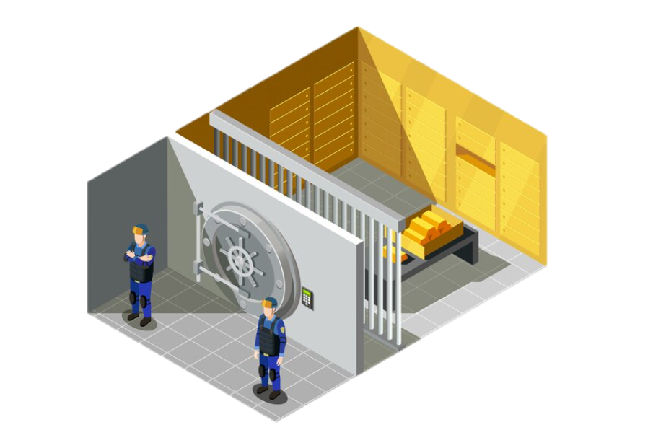

Vault Room
Office
Consulting Area
VIP Meeting Room
Counter
Lobby
Self-service
Area
Reception
Entrance
ATM area
Notes:
银行业务划分区：
前台、ATM、自助业务区、大厅、高柜（对私业务）、低柜（对公业务）、保险柜、VIP会议室、办公室、

Slide 4

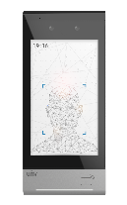
Bank Security Solution
Vault Room
-Smart Intrusion Prevention
-Tri-guard
-Dual-way Talk
-360° Panoramic View
-Heat Map
Non-public Rooms
Transaction Area
-Access Control
-Attendance Management
-4K HD
-Built-in Mic
-Variable Focal
Entrance
-People Counting
-130 dB WDR
-Color Retrieval
Outside
-Ultra-wide field of view
-Clear night IR images
ATM Area
-Built-in Mic
-IK10 & IP67

Slide 5
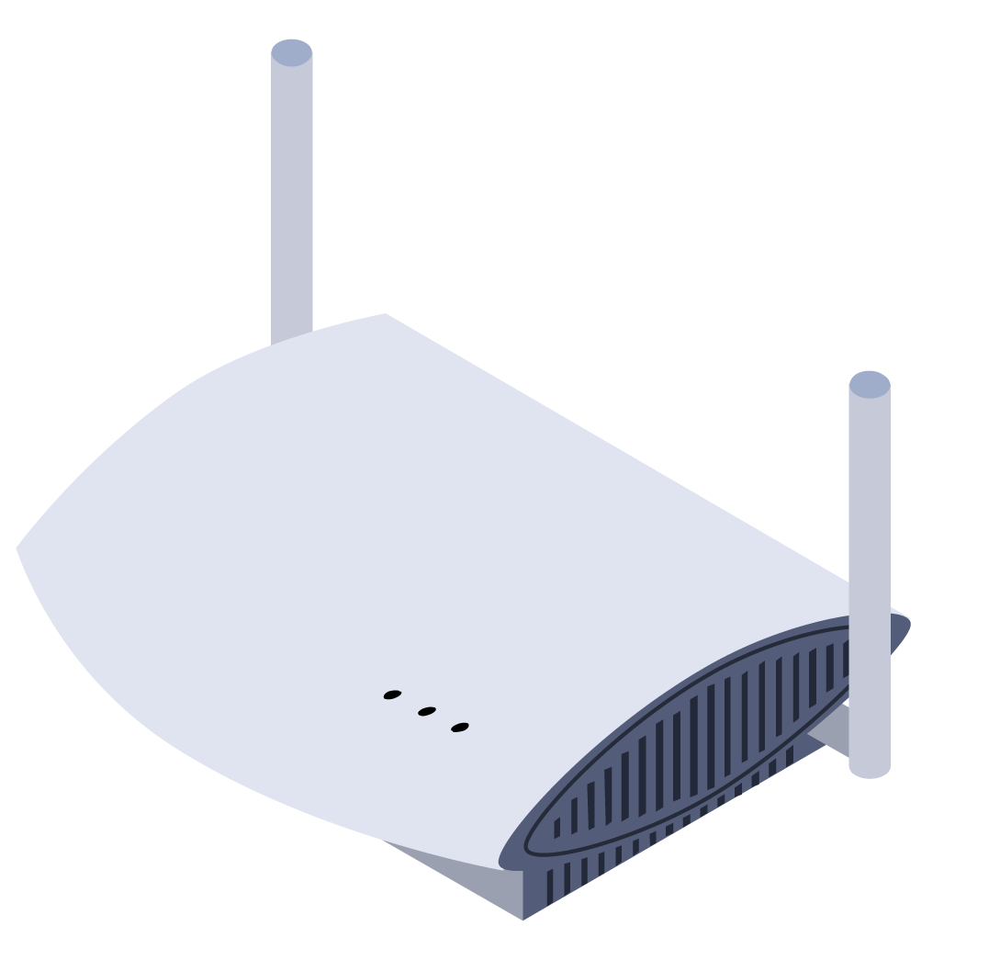
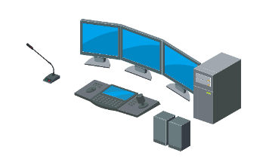

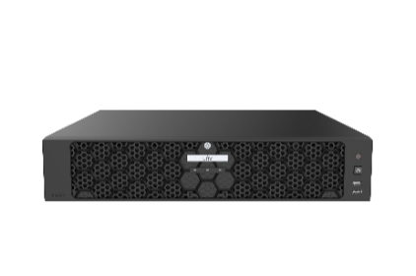

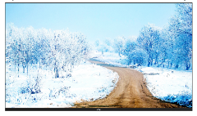
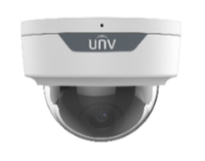
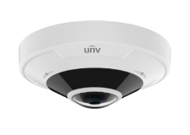
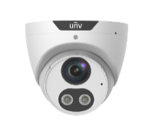
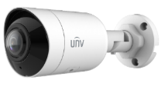
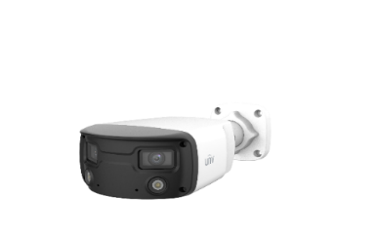
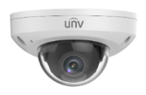
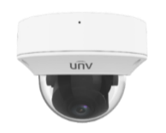
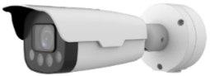
System Architecture - Bank Branch
PC Client
Intelligent NVR
Monitor
Security Room
Router
EZCloud
Mobile Client
LAN
Outside
Parking Lot
Entrance
Lobby
ATM
Transaction Area
Vault
Room
Non-public Rooms
Ultra-Wide Bullet
LPR Camera
Dual Lens Camera
Color Retrieval Dome
Fisheye Camera
Mini Dome
VF Dome
Tri-guard Dome
Face
Terminal

Slide 6
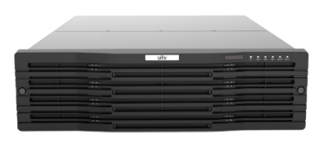
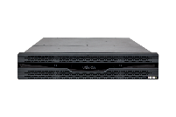
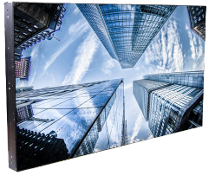

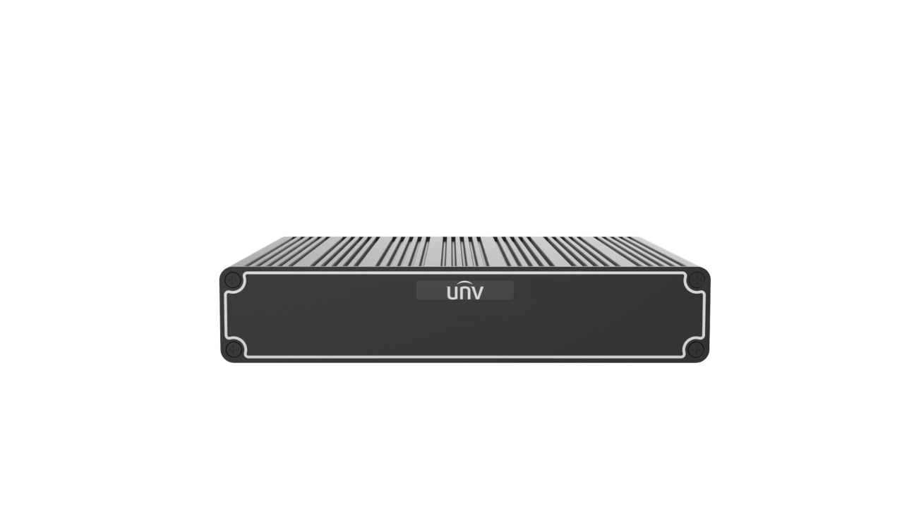
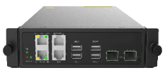
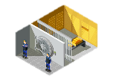

System Architecture - Headquarters Command Center
Hot Spare NVR
VMS
Smart Box
IPSAN
Decoder
Video Wall
LAN
………
Branch 1
Branch 2
Branch 3
Branch 4

Slide 7
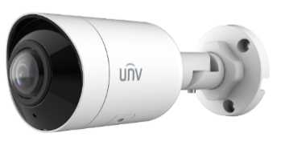
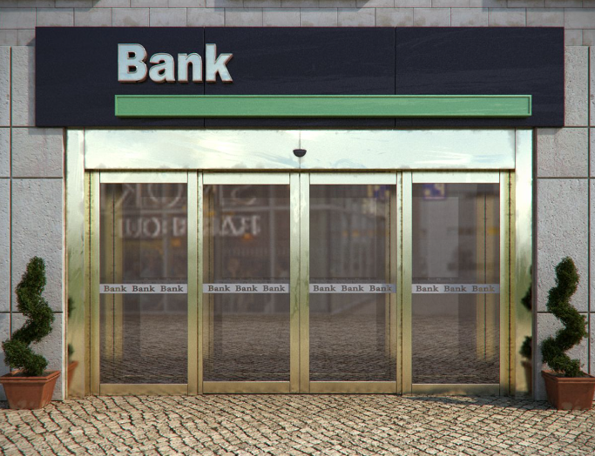
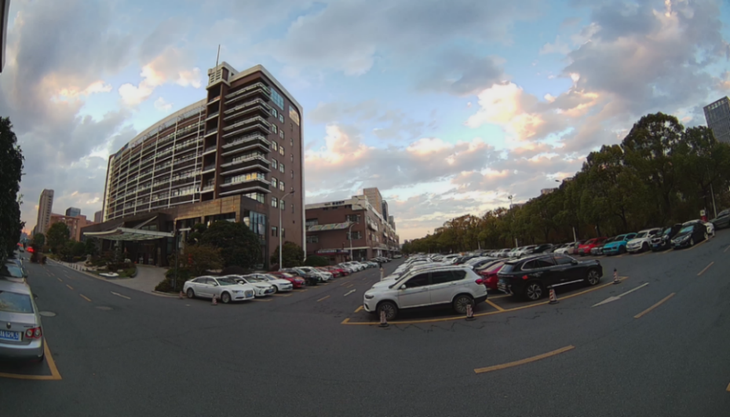
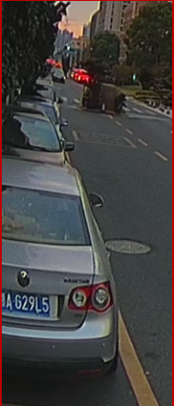
Outside
UNV
5MP 180° Ultra-Wide Mini Bullet Camera
- Wide Angle technology realize the horizontal viewing angle
of 180°, guard the security outside the bank.
- High quality image with 5MP 16:9 ratio.
- Smart intrusion prevention, accurately focus on human, motor
vehicle and non-motor vehicle.
- Excellent night performance, clear night IR images.
Outside the bank gate is an important monitoring scene that cannot be ignored. There is a need for a wide-angle camera that is suitable for outdoor use to cover a wide street view.
Ultra-wide field of view with extreme details

Slide 8

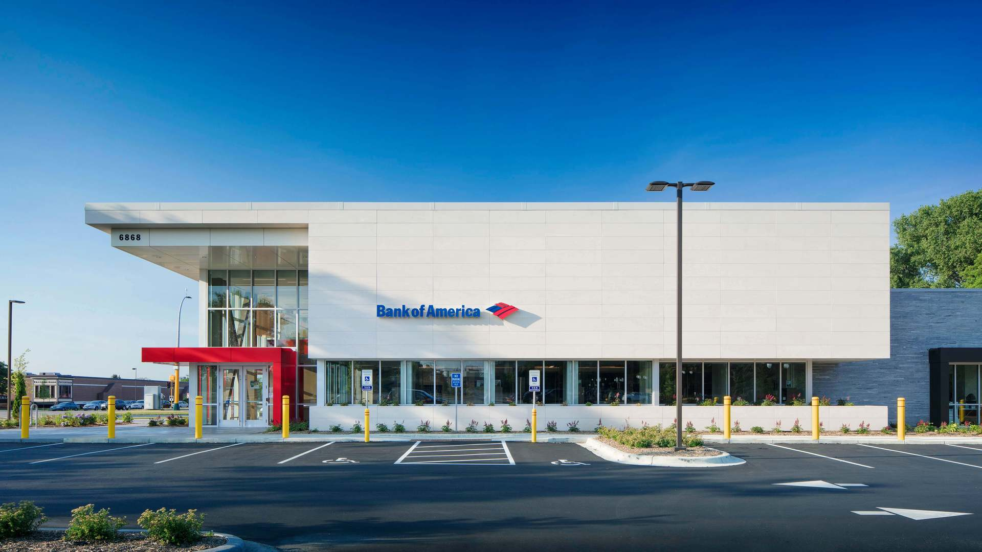








Parking lot
UNV
LPR (License Plate Recognition) Camera
- Bank vehicle whitelist entry management.
- Fast recognition process and passage, open barrier via alarm
I/O quickly after recognition.
- Low labor cost, recognition and barrier-opening automatically,
no need a guard in site.
- Comprehensive record, make sure there's a track record after
accident.
Some banks have their own parking lots for in-house staff, so vehicle access management is also part of the security solution. UNV LPR cameras can work with barrier gate to manage vehicles and improve overall safety.
Supported license plate list
Britain, Eastern Europe, Africa, Saudi Arabia, Pakistan, The Philippines, Singapore, etc.

Slide 9
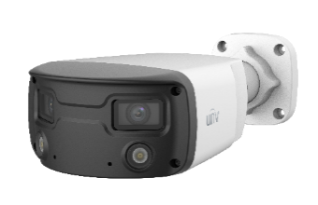
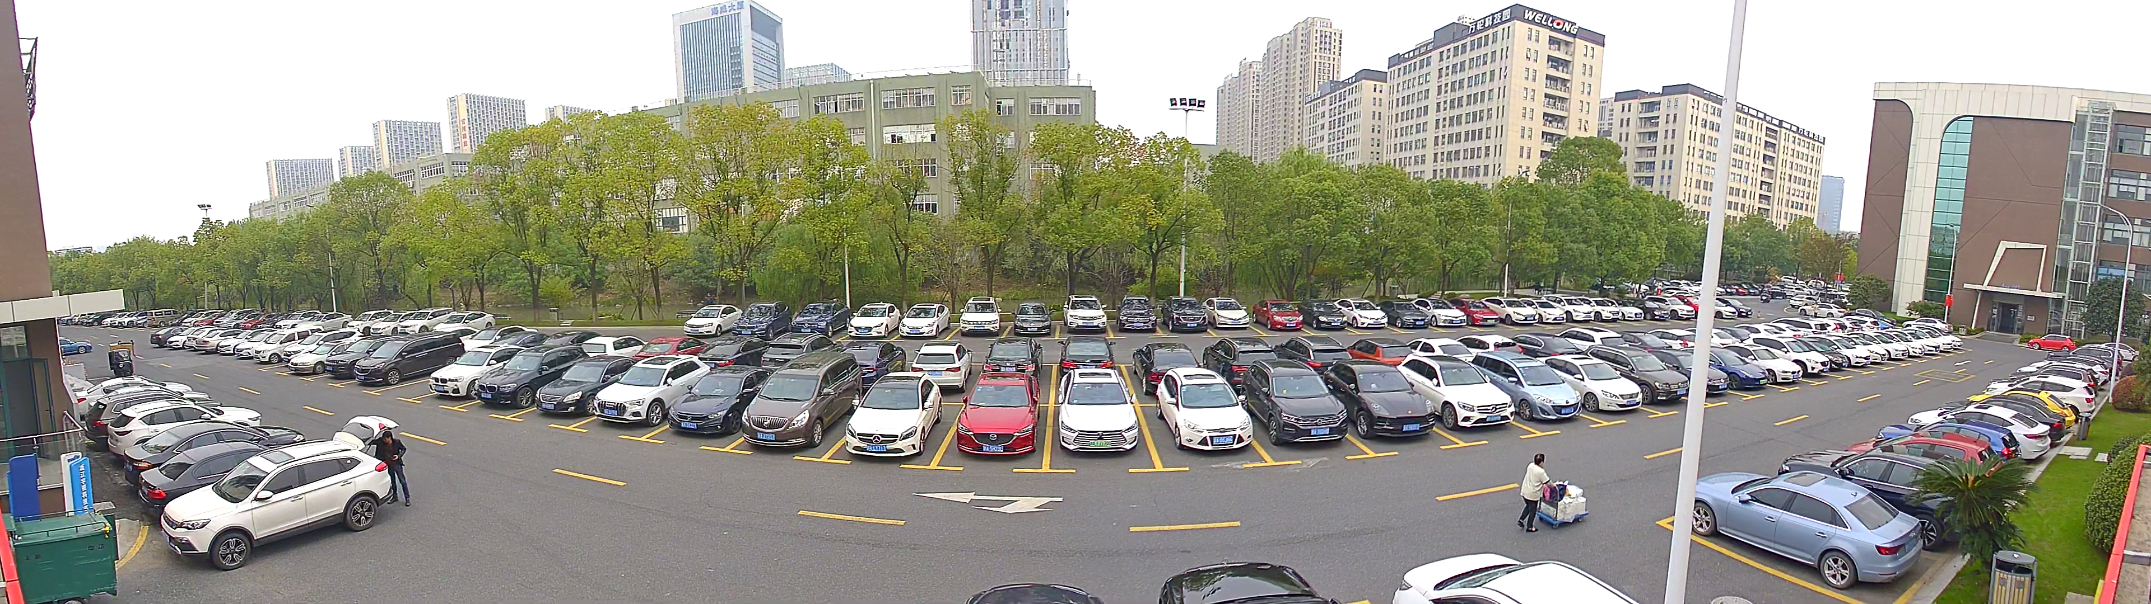
Parking lot
UNV
Double lens 160 ° Wide Angle Camera
- 160° wide angle, 4:1 aspect ratio, cover the whole parking lot.
- Two F1.0 big apertures and two warm LEDs.
- Human body detection.
- One camera with multi-purpose, reduce number of installation.
- Colorhunter technology ensures 24-hour full-color images.
The area of the parking lot is very wide and often requires many cameras to be deployed. UNV's double-lens camera is perfect for the parking lot, not only covering the entire area but also providing 24-hour full-color images.
160° wide angle real effect

Slide 10
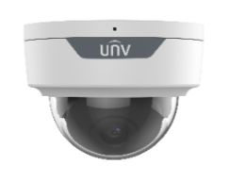
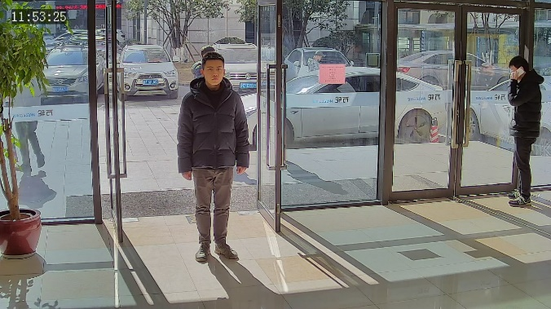
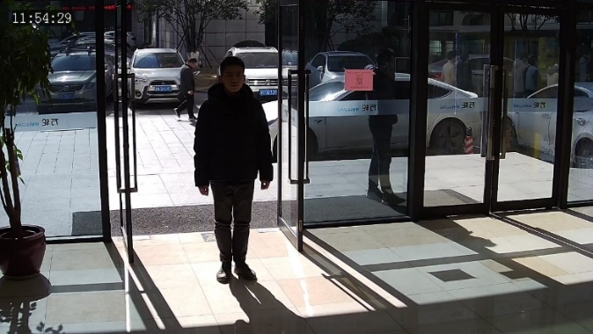
Entrance
UNV
5MP Color Retrieval Dome Camera
- 130dB true WDR technology and Auto Scene Match (WDR),
Smart adjustment of image parameters for perfect image quality.
- 60 fps High Frame Rate allows for clear and effective capture.
- People counting helps business strategy.
- Work with back-end NVR to realize face detection, fast
identification of VIP and blacklist personnel.
- Smart human detection with color retrieval.
As the bank’s first line of defense, the entrance is a very important part. The scene usually faces bright light and this UNV 130 dB WDR camera is the best choice, with rich intelligent functions to secure the entrance.
WDR on
WDR off
Notes:
WDR效果图

Slide 11
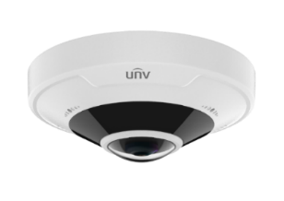

Lobby
UNV
12MP Fisheye 360° Panoramic camera
- 12MP Super high Resolution with true colors and great details.
- 360° Panoramic View, a wide coverage without blind spot.
- Tampering Detection, prevent vandalism and lens blocking.
- Heat Map, Support data export and periodically statistics query.
- Built-in de-warping algorithm.
Only need to install one fisheye camera in the center of the ceiling to cover the whole lobby. UNV fisheye camera can provide various decoding modes to present the panoramic view with good details.
Hardware Decoding & Software Decoding Meet Different Needs
Notes:
热力图

Slide 12



ATM Area
UNV
8MP IK10 Mini Dome Camera
- High quality image with 8MP, 1/3"CMOS sensor.
- LightHunter technology ensures ultra-high image quality in
low illumination environment.
- Built-in Mic to record the scene audio.
- 120dB true WDR technology enables clear image in strong
light scene.
- IK10 vandal resistant and IP67 protection.
ATM area is prone to robbery, vandalism and other criminal acts, so this area requires round-the-clock security. It is recommended to choose waterproof and vandalism-proof IP camera with high resolution.
IP67
IK10
Weatherproof design for outdoor environment
Reliable protection level

Slide 13
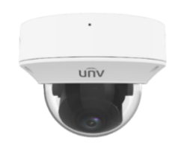


Transaction Area
UNV
8MP Variable Focal Dome Camera
- High quality image with 8MP, track each transaction.
- AF automatic focusing and motorized zoom lens.
- Built-in Mic to record transaction conversation.
- Intelligent People Flow Counting and Crowd Density
function.
- IK10 vandal resistant and IP67 protection.
There are two needs in the transaction area where bank employees directly contact customers behind the counter. The first is the zoom ability of the camera, which can clearly capture the images of money and all exchanged documents. The second one is that the camera can record the audio and once a dispute occurs, it can be investigated afterwards.
04
Built-in Mic
Mic and professional noise reduction algorithm to pick up clear voice by filtering background noise.

Slide 14

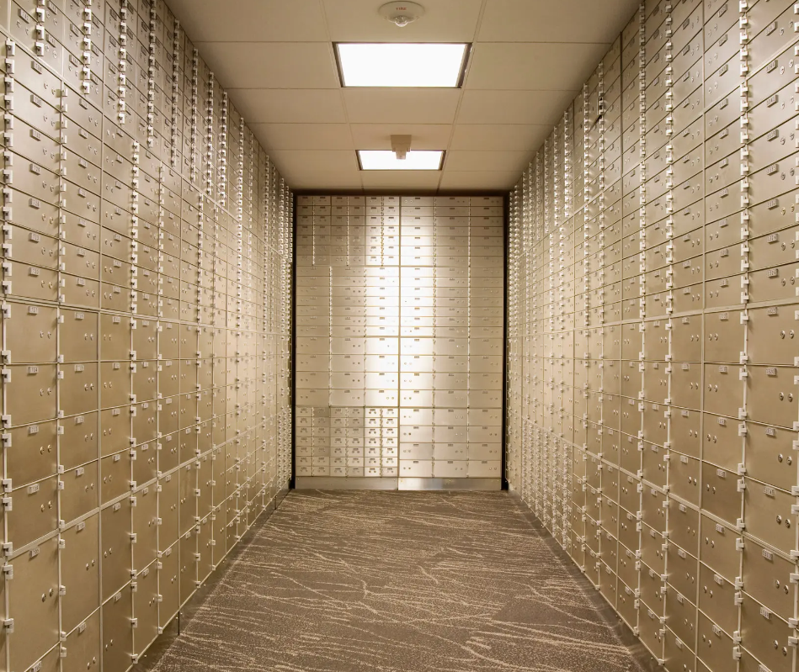

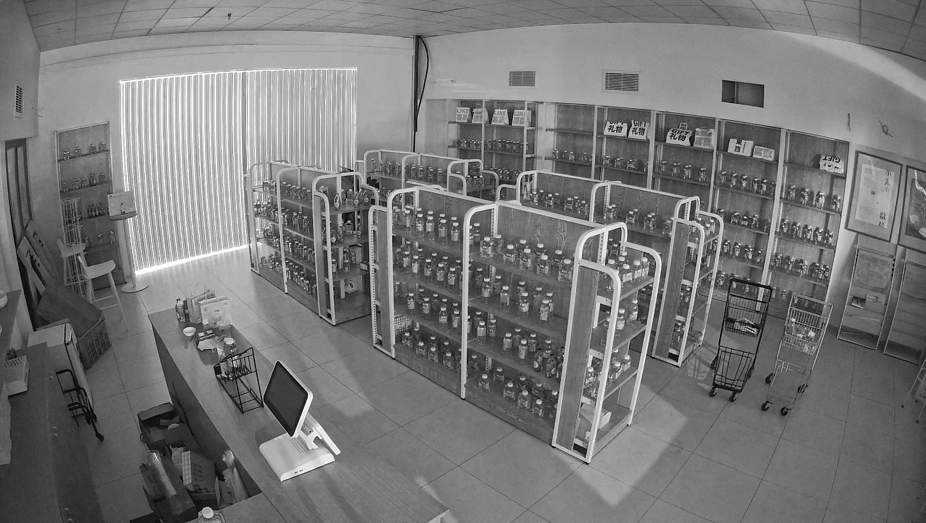

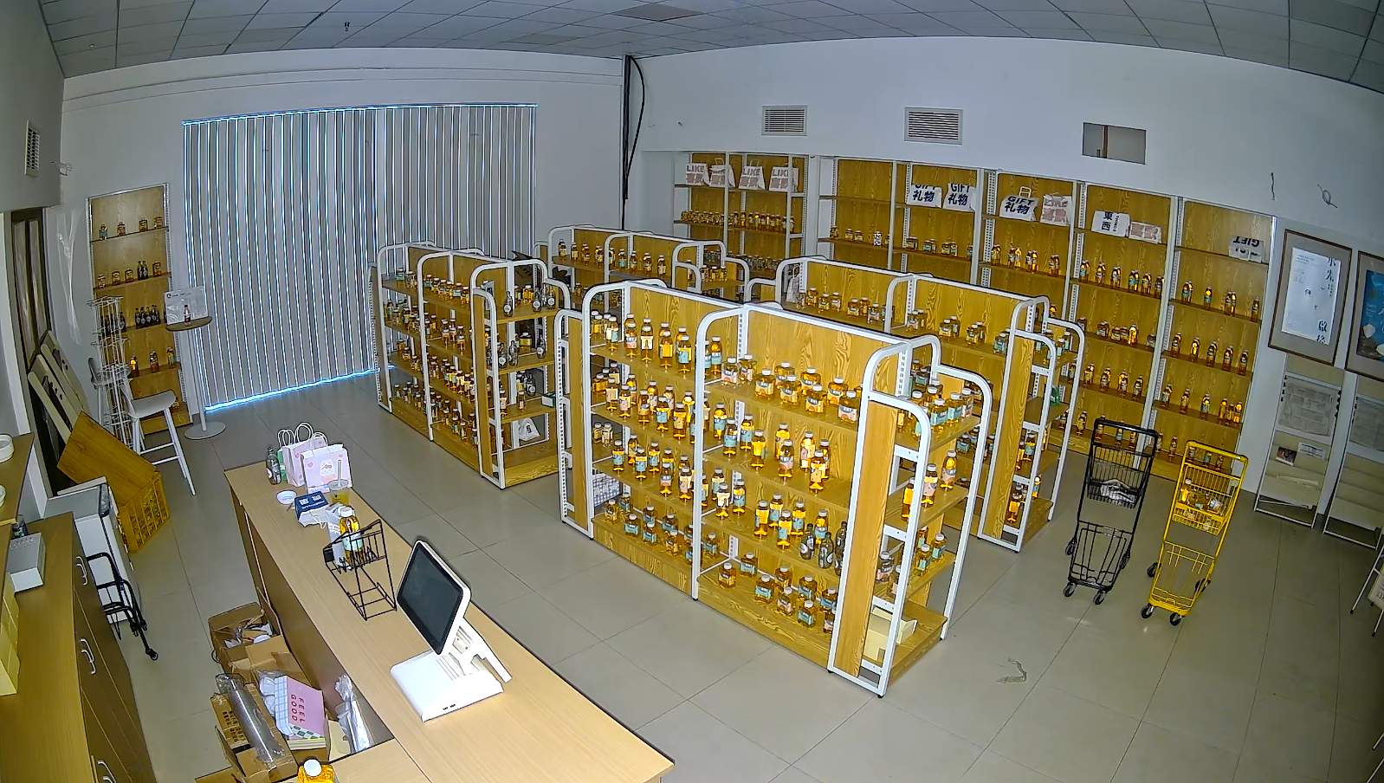
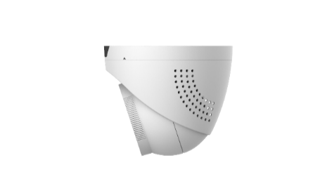
Vault Room
UNV
5MP Tri-guard Dome Camera
- Multiple deterrence modes:
IR mode; Warm light mode; Dual-light mode.
- Smart intrusion prevention, include cross line, intrusion, enter
area, leave area detection.
- Strong deterrence through warm lights and audible Warning.
- Built-in Mic & Speaker, dual-way audio.
The vault room stores a lot of valuables and property, so it requires the highest level of security. UNV Tri-guard camera can help defend this area to detect the abnormal intrusion and send light and audible warning in time.
IR Light
Warm Light
When there is any abnormal intrusion, audible warning works with warm light for active deterrence and intervene.
Leave the area！
Speaker

Slide 15

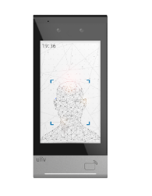

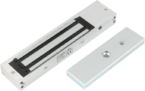
Access Control
UNV face terminal can be deployed at the entrance of bank offices, vault room and VIP meeting room. It will effectively identify bank staff, prevent unauthorized entry of outsiders, and enhance overall security. In and out information can be used for attendance management.
20000 face capacity
Deep learning algorithm, up to 0.2s recognition speed
Face anti-spoofing algorithm
Multiple authentication methods, card + face
Abundant interfaces, including Wiegand, RS485, I/O
API for software integration
LAN
Exit Button
……
Lock

Slide 16

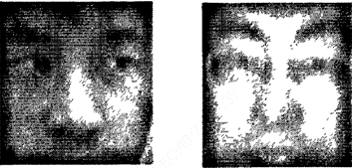
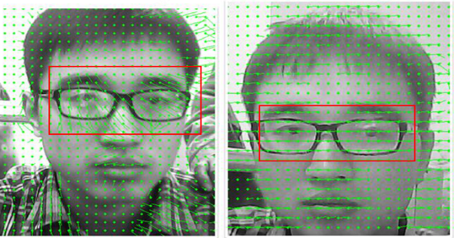
Access Control
Support face anti-spoofing detection
Face Anti-spoofing Technology
Make it free from image and video fraud.
Visible light live detection
Mainly based on image flaws to determine whether the target object is alive such as screen glare, abnormal imaging, etc.
Living body
Photo
Infrared light live detection
The optical flow characteristics of the living body are shown as irregular vector characteristics, while the optical flow characteristics of the photo are regular and orderly vector characteristics.
Living body
Photo

Slide 17

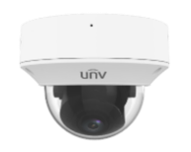
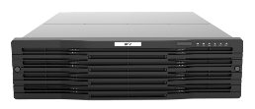
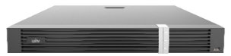


Smart Box - Behavior Analysis
UNV Smart Box is an intelligent edge computing server that can analyze IPC video stream to identify the human skeleton structure and output behavior analysis results.
Intelligent empowerment
Smart Box
IPC
NVR
VMS
Skeleton-based action recognition
Support mainstream algorithms
Identify the human skeleton structure in the video and recognize the behavior based on the skeleton structure.
It has over 20 behavior algorithms. Specific algorithms can be chosen according to the scenario.

Slide 18


Smart Box - Behavior Analysis
Office
On duty detection
Sleep at work detection
Lobby
Lost items detection
Crowd density
Entrance
VIP identification
Black list identification
ATM
Long stay detection
Fight detection

Slide 19
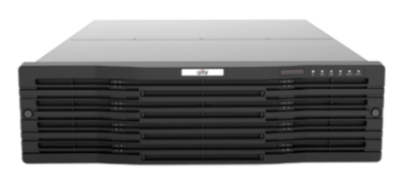
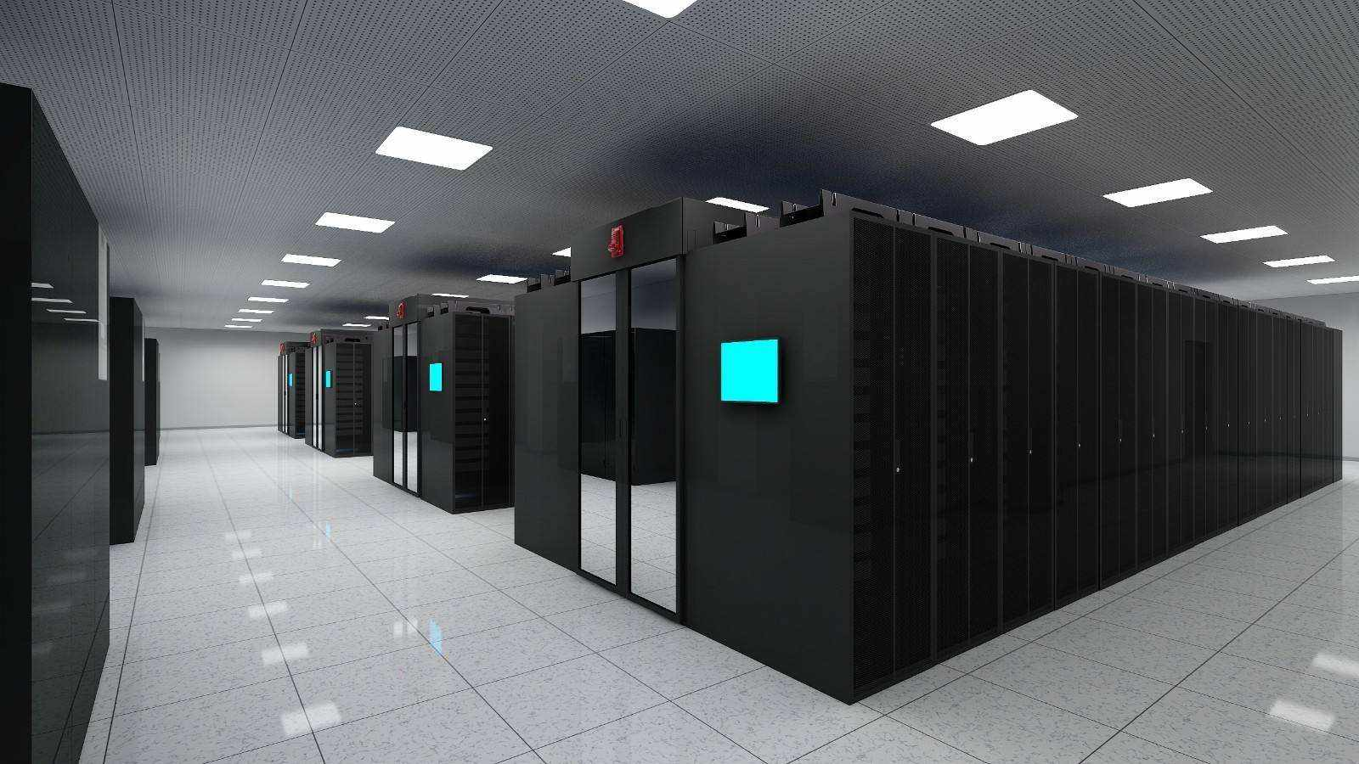
Equipment Room
The headquarters command center consists of two parts: Security Control Room and Equipment room.
Managers and security personnel can get real-time video, receive alarm information, and investigate all security situations in the commander center.
UNV Unicorn
VMS (Video management server)
Unicorn is an integrated surveillance platform that can manage various devices such as IP Camera, NVR, Decoder, Disk Enclosure, IP Storage and other devices. Unicorn has adopted audio/video compression and decompression, embedded system, storage, network and technologies, it is suitable for large-scale security surveillance scenarios, such as managing all branches at the bank headquarters.
Equipment Room
VMS
Equipment Room
IPSAN
UNV
IPSAN - Network storage device
IPSAN is a unified network storage device developed specifically for video security with high performance and reliability. IPSAN adopts a unique hardware structure and combines a large number of storage technologies, including many Uniview patented technologies, so it can prevent data loss and ensure the stability of the service in the storage strategy.

Slide 20
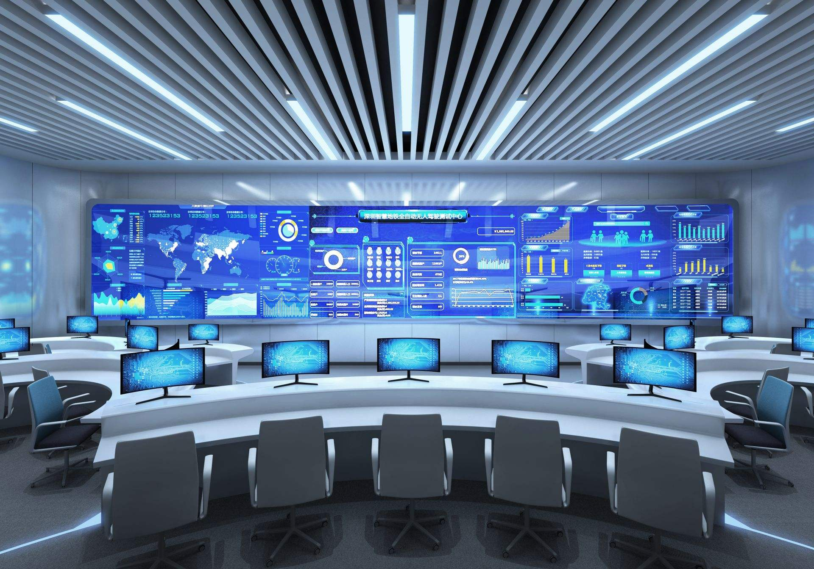
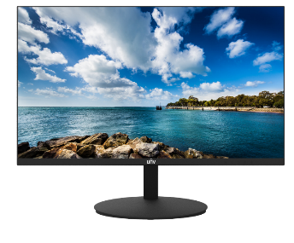
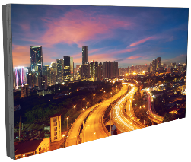
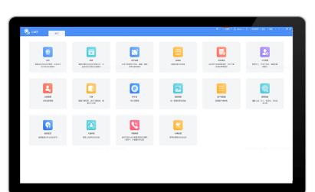
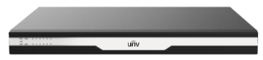
Security Control Room
CCTV Monitor
Dedicated monitor for monitoring, supporting 24/7 long-term uninterrupted operation.
PC Client software
The PC client software specifically designed for the Integrated security platform, which is fast to install, simple to use, and fully meets the requirements of security personnel.
Video Wall
The video wall is designed to achieve intelligent operation, maintenance, and supervision of the entire integrated security system. The video wall can allow multiple people to watch the same interface together, and can be freely spliced and converted according to specific requirements.
High reliability design
Support special splicing compensation
Support screen to prevent cauterizing, image flip
White balance adjustment
Low maintenance cost
24/7 continuous operation
Decoder
Embedded Linux OS ensures 24/7 stable operation and prevents hackers and viruses, Supports 48-ch 1080P@30 videos decoding capability. Supports window opening, roaming and picture-in-picture.
Notes:
补充纯电脑客户端方案作为备选.

Slide 21


Highlight – Intelligent Functions
Face Detection - VIP & Blacklist report
The back-end intelligent NVR508-32E-R-IQ supports face detection function. The front-end cameras stream the video and NVR will compare the face library for face detection. The system will timely report the entry of VIP customers, discover blacklist personnel and alarm in time.
Face Detection
Enter:11 Leave: 4
People Counting - Business strategy
UNV deep learning people counting feature has high accuracy that can output the number of people entering and leaving the bank. The data helps banks analyze customer traffic and determine optimal staffing levels during peak periods.
People Counting

Slide 22



Highlight – Color Retrieval
Color retrieval means that videos can be filtered by the color of a person’s clothes. This would be a very useful intelligent function for post investigation if there is any incident at the bank. Through the color of clothing can quickly locate suspicious people, greatly reducing the search time.
Human Files
Upper and Lower Garment Color
Select date
Select garment color
Retrieval result
Notes:
在VMS上能配套实现吗

Slide 23








NVR Highlight – Universal Block Storage
UBS can help to keep the stability of system, as the foundation of device operation.
UBS framework
Video stream
Video stream goes straight to HDD without through the file system
Storage space in HDD is divided into blocks(usually 256M)
Data in a block is wrote down in order
Application
A
N
B
C
Block Device Driver
D
...
N
HDD
Video stored in NVR
Blocks in HDD
Data in block
Highlight of UBS
Private system
No video loss
Less fragmentation
Formatting
Uniview’s NVR
Against theft
3rd party device
Ensure every hard disk driver in Uniview’s NVR is in UBS system, and it can not be read by 3rd party device
Sequential write of UBS helps it easily with indexes recovery, which makes sure there is no video loss even when encountering with power cut.
Block storage logic minimizes space utilization, reduces fragmentation, shorts write time, and reduces heat dissipation

Slide 24


NVR Highlight - Redundant mode, keep data integrity
Redundant storage can help with data integrity, and varied modes are designed to realize the most suitable solution.
Redundant
RAID 0
RAID 1
RAID 5
RAID 6
The most cost-effective solution for redundance.
For easy, prime and pro series.
Large-scale concurrent fast reads and writes.
For easy, prime and pro series.
Strong redundancy performance, strong reliability.
For easy, prime and pro series.
A solution with at least 3 hard disks, redundancy realiability between RAID 0 and RAID1.
For easy, prime and pro series.
A solution with at least 4 hard disks, redundancy realiability between RAID 0 and RAID1.
For prime and pro series.
When countering breakdown of machine or hard disk, data can be recovered by redundant mode
Diverse mode leverages the integrity of different NVRs
RAID 10
Combine the features and advantages of RAID 1 and RAID 0, while support high concurrent access.
For prime and pro series.
Combines the features and advantages of RAID 5 and RAID 0 level to give users an enhanced performance with their storage devices.
Only for pro series.
Combines the features and advantages of RAID 6 and RAID 0 level to give users an enhanced performance with their storage devices.
Only for pro series.

Slide 25


















NVR Highlight - Video Retrieval, focused tags
General retrieval
Focus on channel and calendar
Event retrieval
Focus on events
Synchronous playback
Increase the efficiency
Video tag
Decrease the retrieval range
Retrieve by event tags
Faster in every disassembled retrieval range
9:30
9:30
The calendar
Event
Normal
Audio Detection
Face
Detection
Leave Area
Enter Area
Object Removed
Scene Change
Detection
9:30
9:30
No video
Shrink the range from months to days
Synchronous playback locates alarm channel when you wonder where events happen.
The time axis
10:00
16:00
Event
Normal
Intrusion Detection
Auto Tracking
Defocus Detection
Object
Left Behind
Cross Line
Detection
Shrink the range from days to seconds

Slide 26


















NVR Highlight - Image Retrieval, detailed classification
Event retrieval
Face retrieval
Vehicle retrieval
Channel, time, alarm type, target type
Channel, time, gender, age, glasses and face
Channel, time, plate number, plate color, vehicle color
Snapshot and corresponding video (10s before and after the alarm)
Snapshot and corresponding video (10s before and after the alarm)
Support fuzzy query, using “ *” to represent one or more characters
Snapshot and corresponding video (10s before and after the alarm)
Fuzzy searching is not supported

Slide 27




NVR Highlight -Data Safe
ANR technology
When the network is broken, the camera's video will be stored to the SD card of the device. After the network is restored, the video will be automatically synchronized to the NVR.
SD Card
N+1 Hot Spare
When an NVR fails, the hot spare automatically takes over services. When the faulty NVR recovers, the hot spare releases services and migrates data back.
Notes:
As we know, NVR video recording is the most important reliability functions in software no video loss. UNV has a technology to guarantee before and after video transmission ANR. Video stored in SD card temperately when the connection is broken, so it will be no video loss. And when the Camera reconnect to NVR, the video transmission goes to HDD in NVR. Really reliable.

Slide 28


VMS Highlight - User and Role Management
The user management system contains two parts: User and Role.
“Role" is used to define a type of person.
"User" is used to define a individual person or account.
Role
Security for
Branch 1
Security for
Branch 2
Security for
Specific Zone
Security Captain
Manager
Preview
Preview
Preview
Preview
Preview
Playback
Playback
Playback
Playback
Playback
E-map
E-map
E-map
E-map
E-map
Audio
Audio
Audio
Audio
Audio
Alarm
Alarm
Alarm
Alarm
Alarm
Recording Plan
Recording Plan
Recording Plan
Recording Plan
Recording Plan
Branch 1
Branch 1
Branch 1
Branch 1
Branch 1
Branch 2
Branch 2
Branch 2
Branch 2
Branch 2
Branch 3
Branch 3
Branch 3
Branch 3
Branch 3
Branch 4
Branch 4
Branch 4
Branch 4
Branch 4
Log
Log
Log
Log
Log
Email
Management
Management
Management
Management
……
……
……
……
……
For example, you can create several roles first, Configure detail permissions for each role.

Slide 29



VMS Highlight - Central Storage
The video can be recorded in VMS or IPSAN.
When recorded in VMS, the recording stream will be same as live view stream, and the playback stream will be sent from VMS to PC client and decoder.
When recorded in IPSAN, the recording stream will be sent to IPSAN directly, and the playback stream will be sent from IPSAN to PC client and decoder.
Both LAN and WAN support central storage
Recording Stream
Playback Stream
NVR
VMS
PC Client
Network
VMS
PC Client
NVR
Network
IPSAN
It is very easy to make recording schedule in Unicorn, you can just draw schedule by virtual pencil, and the schedule can be saved as template and easily be applied to other channels.
0
1
2
3
4
5
6
7
8
9
10
11
12
13
14
15
16
17
18
19
20
21
22
23
24
Monday
Tuesday
Wednesday
Thursday
Friday
Saturday
Channel 01
Sunday
Time Template
Holiday

Slide 30
Products List
Scenarios | Cost Effective Support video and storage only |  | Middle Level Support most functions for separate bank branch |  | High Performance Supports all functions for headquarters and bank branches
 | Products | Functions | Products | Functions | Products | Functions
Outside | IPC2124LE-ADF28KM-G | 4MP Bullet | IPC2105SB-ADF16KM-I0 | 5MP Wide Angle Bullet | IPC2105SB-ADF16KM-I0 | 5MP Wide Angle Bullet
Parking Lot |  |  | HC121@TS8CR-Z | LPR Camera | HC121@TS8CR-Z | LPR Camera
 | IPC2314LE-ADF40KM-WL | 4MP Bullet | IPC2K24SE-ADF40KMC-WL-I0 | 4MP Dual Lens | IPC2K24SE-ADF40KMC-WL-I0 | 4MP Dual Lens
Entrance | IPC322SS-ADF28K-I1 | 2MP Dome | IPC324SS-ADF28K-I1 | 4MP Dome | IPC325SS-ADF28K-I1 | 5MP Dome
Lobby | IPC3534LB-ADZK-H | 4MP Dome | IPC815SB-ADF14K-I0 | 5MP Fisheye | IPC86CEB-AF18KC-I0 | 12MP Fisheye
ATM Area | IPC312SB-ADF28K-I0 | 2MP Mini Dome | IPC314SB-ADF28K-I0 | 4MP Mini Dome | IPC318SB-ADF28K-I0 | 8MP Mini Dome
Transaction Area | IPC3532LB-ADZK-H | 2MP VF Dome | IPC3235SB-ADZK-I0 | 5MP VF Dome | IPC3238SB-ADZK-I0 | 8MP VF Dome

Slide 31
Products List
Scenarios | Cost Effective Support video and storage only |  | Middle Level Support most functions for separate bank branch |  | High Performance Supports all functions for headquarters and bank branches
 | Products | Functions | Products | Functions | Products | Functions
Vault Room | IPC3614SB-ADF28KMC-I0 | Tri-guard 4MP camera | IPC3615SB-ADF28KMC-I0 | Tri-guard 5MP camera | IPC3618SB-ADF28KMC-I0 | Tri-guard 8MP camera
Access Control |  |  | OET-573B-HM-R | 7 inch face terminal | OET-573B-HM-R | 7 inch face terminal
Branch Security Room | NVR304-32S | NVR | NVR508-32E-R-IQ | Intelligent NVR | NVR508-32E-R-IQ | Intelligent NVR
 | MW3224-V | 23.8" Monitor | MW3243-F-V | 43" Monitor | MW3255-F-V | 55" Monitor
Headquarters Command Center |  |  |  |  | Unicorn | VMS
 |  |  |  |  | DC5601 | Decoder
 |  |  |  |  | ECS-508B-XP | 8ch Smart BOX
 |  |  |  |  | NI-VX1612-C | Recording Storage
Note：
* The list does not include all kinds of accessories(HDD, Cable, Bracket, Power Supply), please purchase according to the actual requirement.
* Intelligent NVR NVR508-32E-R-IQ is expected to be released in Q2 of 2024.

Slide 32

BICEC Bank, Cameroon
500+ HD cameras
Pro series NVR
RAID Storage

Slide 33

Shanghai DBS Bank
1000 HD cameras
Unified Management Platform
High Stability Storage

Slide 34

Shanghai BEA Bank
100 Branches
HD IPC & NVR

Slide 35

Unlimited New View

